Slide 1
Lebanon Dam South Ladder Fish Counter
Favored Design & Schedule Presentation/Discussion

Slide 2
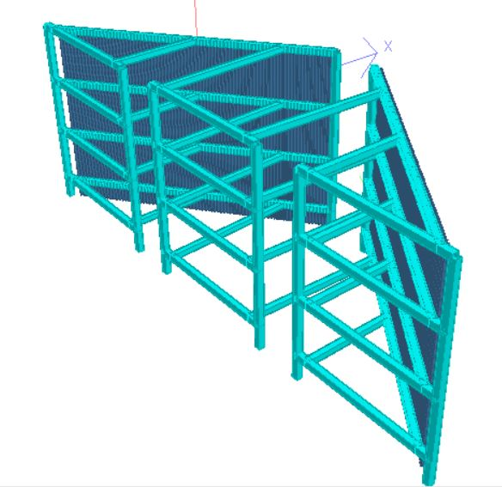
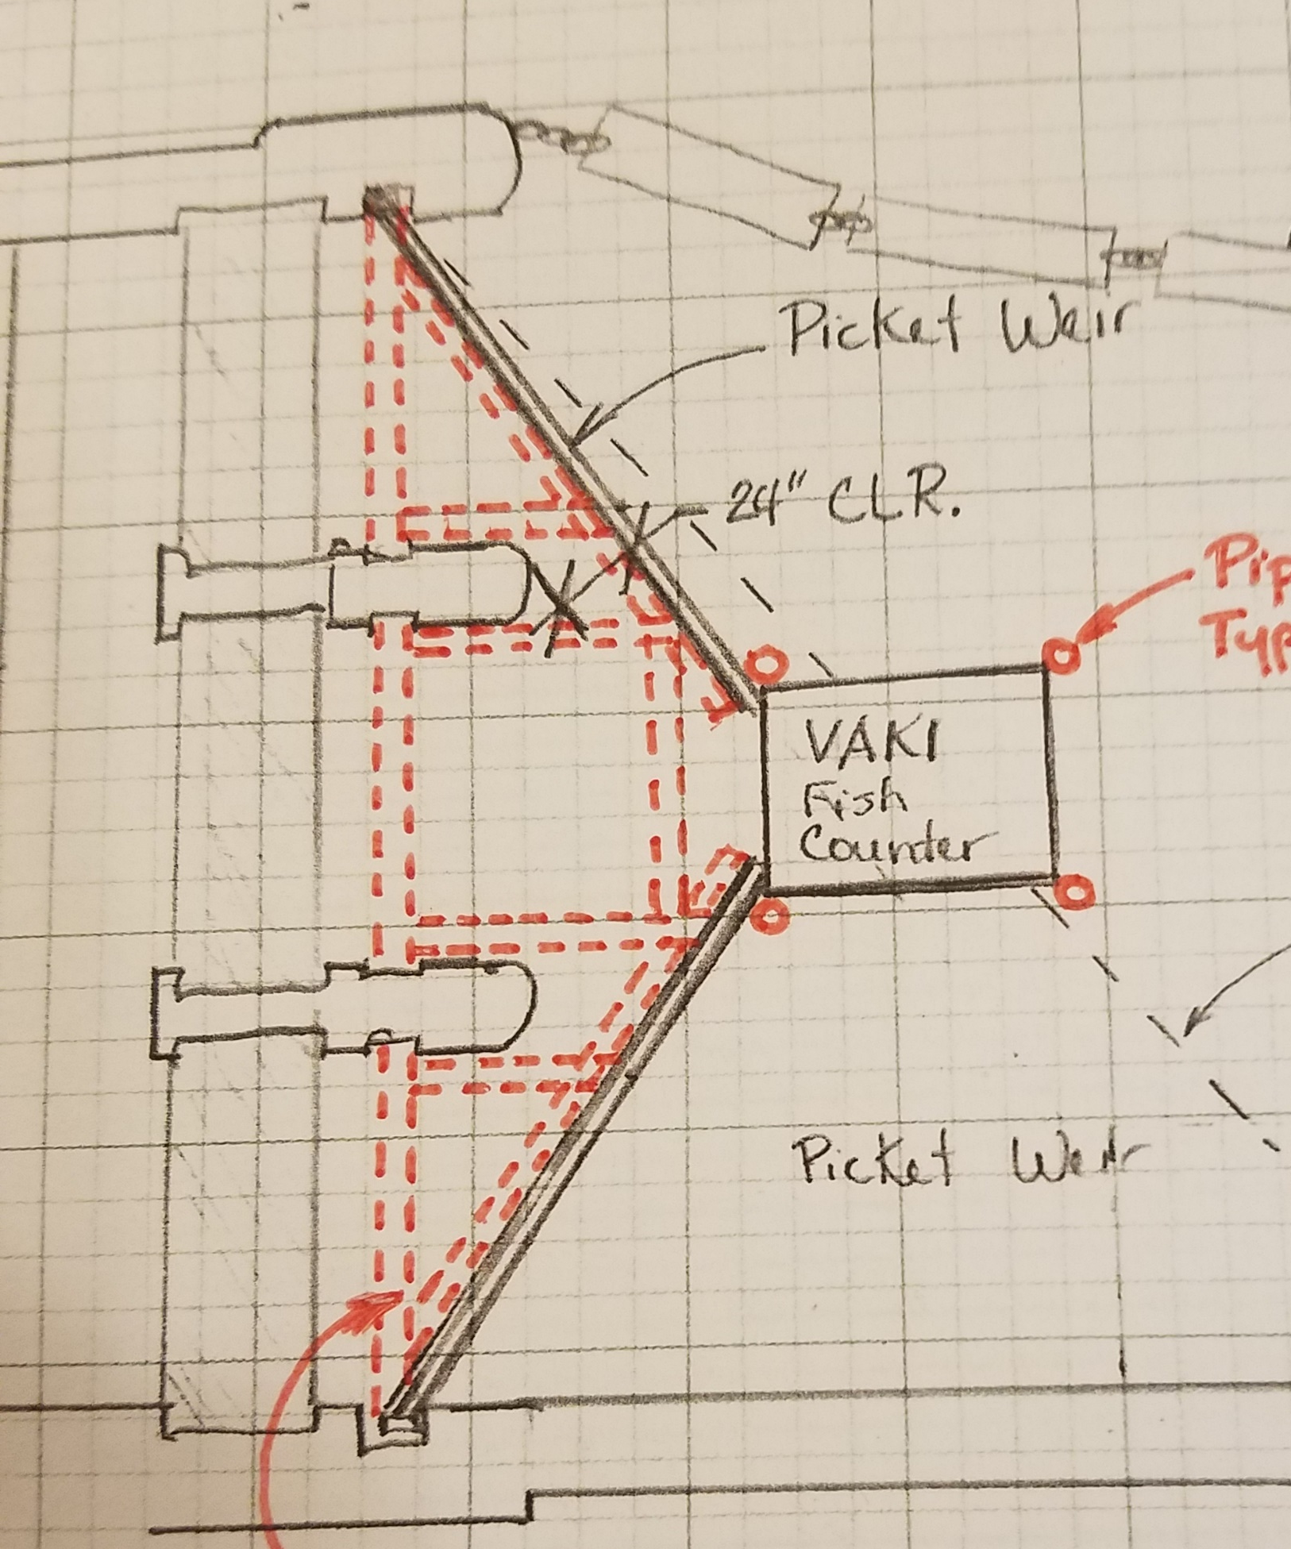
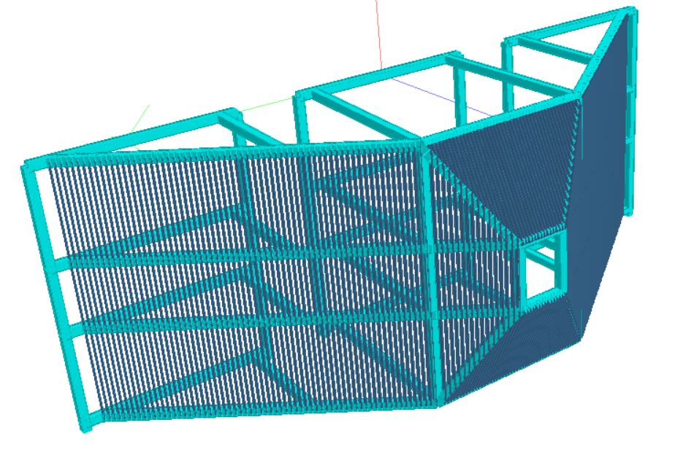
Favored Alternative at
South Ladder:
Steel Frame Design

Slide 3
